Slide 1
DOCUMENT OBJECT MODEL

Slide 2
DOM
JavaScript is the programming language used to build Ajax applications.
combined with the <DIV> </DIV> and <SPAN> </SPAN> tags, -> dynamically insert text at pre-set locations within your applications
Document Object Model -> complete control over the layout of your application’s web pages.

Slide 3
DOM
The Document Object Model creates a tree representation of web pages
To work with different Document Object Model properties and methods
To walk the Document Object Model tree and retrieve element information
To use the Document Object Model to modify tree layout and dynamically update the appearance of web pages

Slide 4
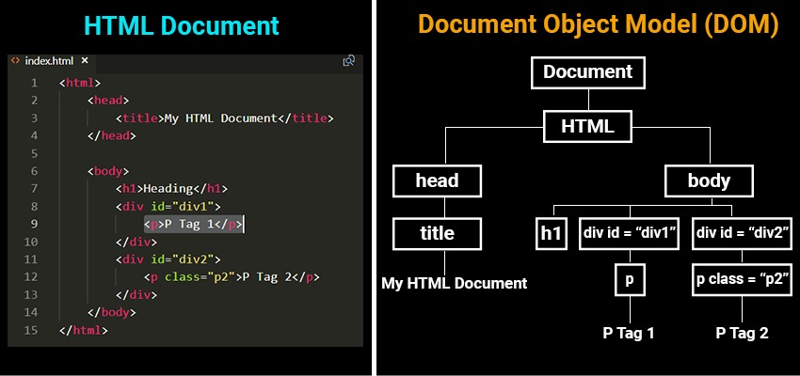
DOM Tree

Slide 5
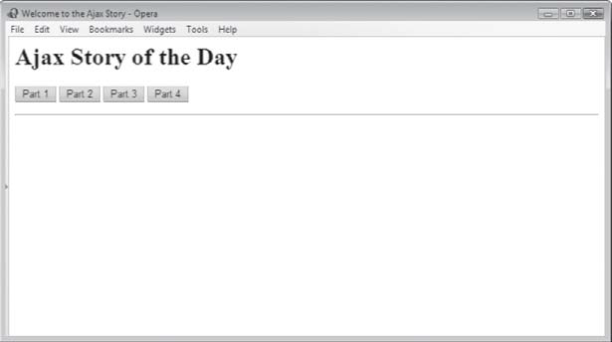
Ajax: Story of the Day

Slide 6
DOM
With the object model, JavaScript gets all the power it needs to create dynamic HTML:
JavaScript can change all the HTML elements in the page
JavaScript can change all the HTML attributes in the page
JavaScript can change all the CSS styles in the page
JavaScript can remove existing HTML elements and attributes
JavaScript can add new HTML elements and attributes
JavaScript can react to all existing HTML events in the page
JavaScript can create new HTML events in the page

Slide 7
Finding HTML Elements
Method Description document.getElementById(id) Find an element by element id document.getElementsByTagName(name) Find elements by tag name document.getElementsByClassName(name) Find elements by class name Changing HTML Elements
Property Description element.innerHTML = new html content Change the inner HTML of an element element.attribute = new value Change the attribute value of an HTML element element.style.property = new style Change the style of an HTML element Method Description element.setAttribute(attribute, value) Change the attribute value of an HTML element Adding and Deleting Elements
Method Description document.createElement(element) Create an HTML element document.removeChild(element) Remove an HTML element document.appendChild(element) Add an HTML element document.replaceChild(new, old) Replace an HTML element document.write(text) Write into the HTML output stream
Adding Events Handlers
Method Description document.getElementById(id).onclick = function(){code} Adding event handler code to an onclick event Finding HTML Objects
The first HTML DOM Level 1 (1998), defined 11 HTML objects, object collections, and properties. These are still valid in HTML5.
Later, in HTML DOM Level 3, more objects, collections, and properties were added.
Property Description DOM document.anchors Returns all <a> elements that have a name attribute 1 document.applets Deprecated 1 document.baseURI Returns the absolute base URI of the document 3 document.body Returns the <body> element 1 document.cookie Returns the document's cookie 1 document.doctype Returns the document's doctype 3 document.documentElement Returns the <html> element 3 document.documentMode Returns the mode used by the browser 3 document.documentURI Returns the URI of the document 3 document.domain Returns the domain name of the document server 1 document.domConfig Obsolete. 3 document.embeds Returns all <embed> elements 3 document.forms Returns all <form> elements 1 document.head Returns the <head> element 3 document.images Returns all <img> elements 1 document.implementation Returns the DOM implementation 3 document.inputEncoding Returns the document's encoding (character set) 3 document.lastModified Returns the date and time the document was updated 3 document.links Returns all <area> and <a> elements that have a href attribute 1 document.readyState Returns the (loading) status of the document 3 document.referrer Returns the URI of the referrer (the linking document) 1 document.scripts Returns all <script> elements 3 document.strictErrorChecking Returns if error checking is enforced 3 document.title Returns the <title> element 1 document.URL Returns the complete URL of the document 1

Slide 8
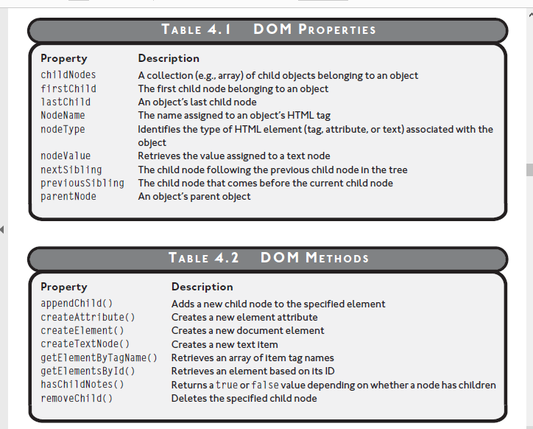

Slide 9
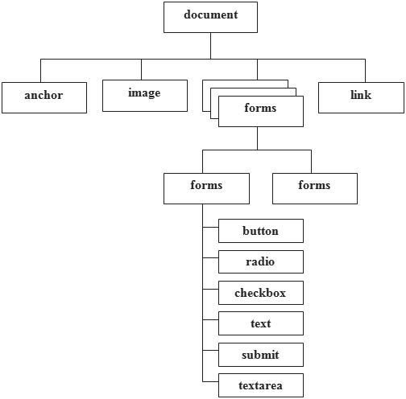
WALKING THE DOM TREE

Slide 10
Accessing DOM Elements by ID
<HTML>
<HEAD>
<TITLE>Demo: Accessing DOM Elements by ID</TITLE>
<SCRIPT language = "javascript" type = "text/javascript">
<!-- Start hiding JavaScript statements
function SetAlarm() {
document.getElementById('DivTrgt').innerHTML = "Charge!"
}
// End hiding JavaScript statements -->
</SCRIPT>
</HEAD>
<BODY onload = " SetAlarm()">
<H1>Knock Knock!</H1>
<DIV id="DivTrgt"> </DIV>
</BODY>
</HTML>

Slide 11
DOM Demo
<HTML>
<HEAD>
<TITLE>Demo: Dissecting the DOM Tree</TITLE>
</HEAD>
<BODY ID = "BodyTag">
<H1 ID = "HeadTag">DOM Demo</H1>
<P ID = "ParaTag">Let's examine this page's DOM tree!</P>
</BODY>
</HTML>

Slide 12
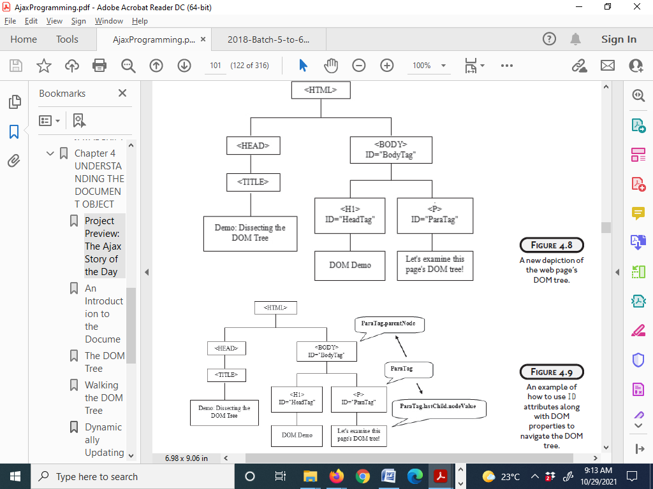

Slide 13
DYNAMICALLY UPDATING WEB PAGE CONTENT
<HTML>
<HEAD>
<TITLE>Demo: Working with mouse event handlers</TITLE>
<SCRIPT LANGUAGE = "JavaScript" TYPE = "Text/JavaScript">
function ChangePageLayout() {
var newParagraph = document.createElement("p");
var newTextNode = document.createTextNode('The DOM Rocks!');
document.getElementById('trgtDiv').appendChild(newParagraph);
document.getElementById('trgtDiv').appendChild(newTextNode);
}
</SCRIPT>
</HEAD>
<BODY>
<H1>DOM Demonstration</H1>
<FORM>
<INPUT type = "button" value = "Click on Me" id = "formButton"
onclick = "ChangePageLayout()">
</FORM>
<DIV id = "trgtDiv"> </DIV>
</BODY>
</HTML>

